Slide 1
FAANG Stock Market Analysis
Deep Dive into Financial Performance & Investment Insights
Welcome everyone. Today, I’ll walk you through a comprehensive analysis of the FAANG companies — Facebook, Apple, Amazon, Netflix, and Google — using both interactive dashboards and deep financial insights.
Presented by: Shady Mayez

Slide 2
Why FAANG?
Over the past decade, five companies — Facebook, Amazon, Apple, Netflix, and Google — have not only shaped our digital lives but also our investment portfolios. But are they all growing equally? Are they equally risky? What do the numbers tell us?

Slide 3
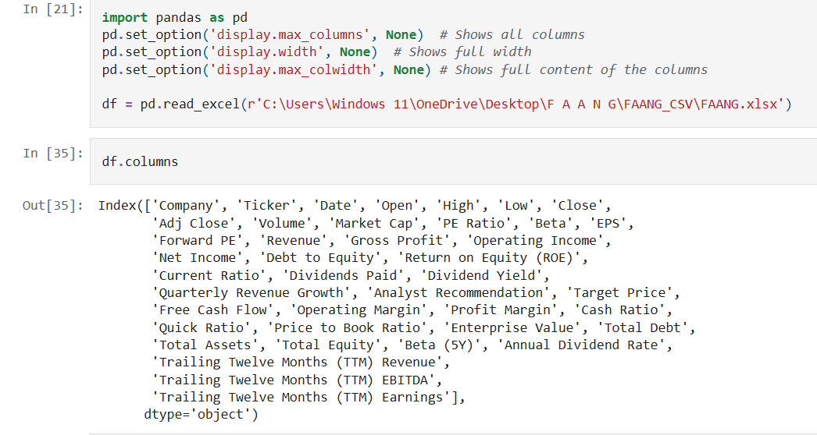
Data Sources
We collected historical stock data for FAANG from Kaggle as xlsx file

Slide 4
FAANG Dataset
Overview
Key Issue: The dataset cannot be cleaned for outliers as it combines data from five different companies.
Solution: Split the dataset into separate subsets, one for each company.
Observations
Amazon and Netflix
These companies do not provide dividends.
Focus is on reinvestment rather than distributing profits to shareholders.
Columns with Unique Values
Only the following columns provide unique and reliable data across companies:
Company, Ticker, Open, High ,Low, Adj Close, Close, Volume
Suspicious Data
Some columns like Market Cap, PE Ratio, Target, EPS, and Analyst Recommendations show the same values across companies for the date 10/17/2024.
These values may have been manually filled or copied from other data (possibly from 10/16/2024) and are not reliable for analysis.
18-10-2024 - Market holiday but there is a data available

Slide 5
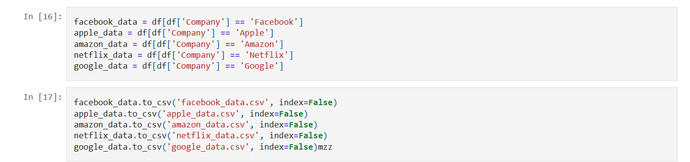
Splitting the FAANG Dataset
Data Splitting
Split the FAANG dataset into five separate datasets, one for each company.
Column Selection - In Splited Dataset
Retain only the unique and reliable columns:
Company, Ticker, Open, High, Low, Adj Close, Close, and Volume.
Exclude Manual Data - In Splited Dataset
Exclude the data for 10/17/2024 as it appears to be inconsistent and unreliable.

Slide 6
Two-Stage Approach to FAANG Stock Market Analysis
Stage 1: Individual Company Analysis
- Performed standard financial analysis for each company:
Stock price trends (historical performance)
Volume and volatility patterns
Moving averages (6M, 12M, 24M smoothing)
Profitability KPIs (EPS, ROE, Net Margin, Free Cash Flow)
- Built company-specific dashboards to evaluate:
How the company performs over time
Whether it’s growing or maturing
Its financial health and market sentiment
Stage 2: Cross-Company Comparison
- Built comparison dashboards to answer:
Who’s more profitable?
Who offers the best return per unit of risk?
Which stock may be undervalued?
- Visualized:
Valuation Ratios: P/E, PEG, EV/EBITDA
Profitability & Growth Metrics: EPS, Net Margin, CAGR
Risk Metrics: Beta, Drawdown, Sharpe Ratio
Market Cap, Volume, Free Cash Flow
- Created recommendation models based on KPIs
At this stage, our goal was to treat each FAANG stock as its own business case. We analyzed its trends, efficiency, and investor behavior — almost like giving each company its financial report card.
At this stage, our goal was to treat each FAANG stock as its own business case. We analyzed its trends, efficiency, and investor behavior — almost like giving each company its financial report card.

Slide 7
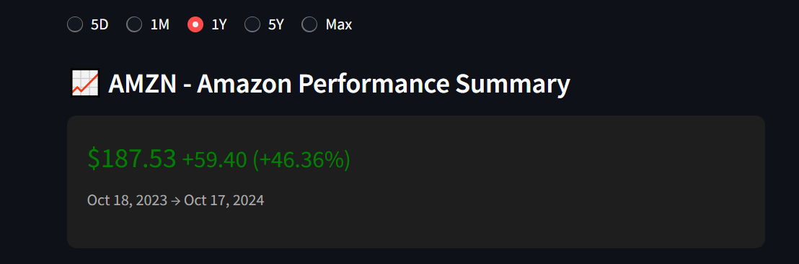
Company Performance Overview
Let’s begin by understanding how this stock has performed over the past year. The current price is $187.53, which represents a gain of $59.40 from a year ago — that’s a remarkable +46.36% increase in value. This performance shows strong investor confidence and market momentum during this period.

Slide 8
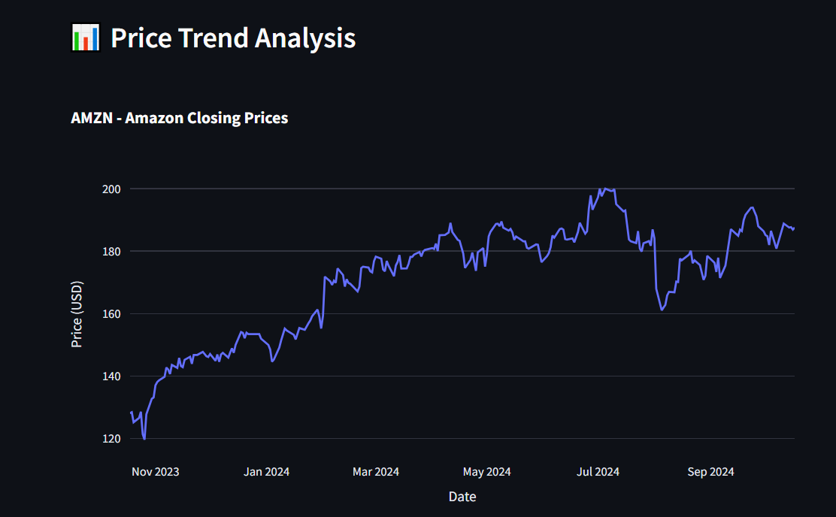
Price Trend Over the Past Year
Here’s how the price evolved day by day. We can identify clear uptrends, corrections, and consolidation zones. This trend analysis helps us recognize long-term direction and volatility levels, which are crucial for strategic decisions.

Slide 9
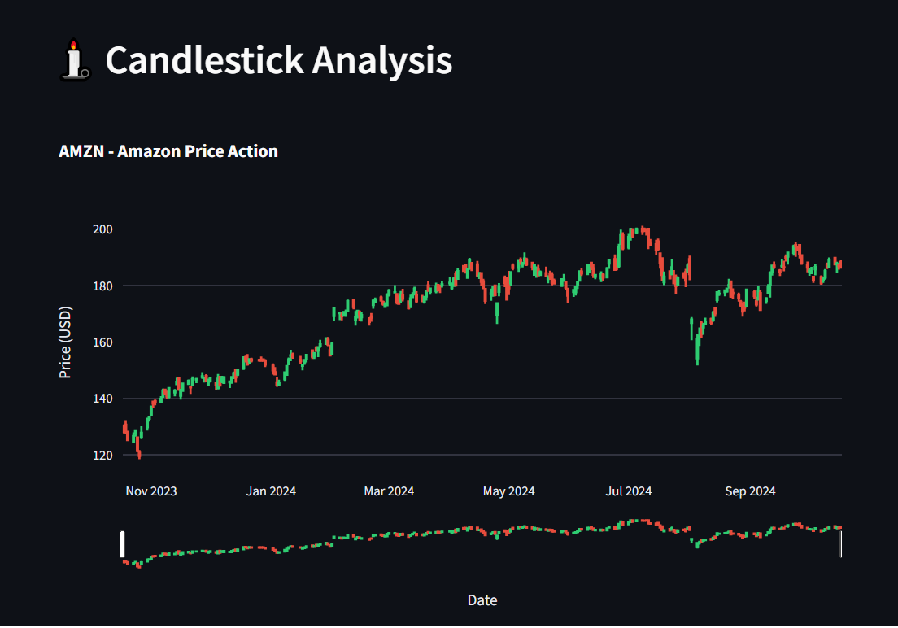
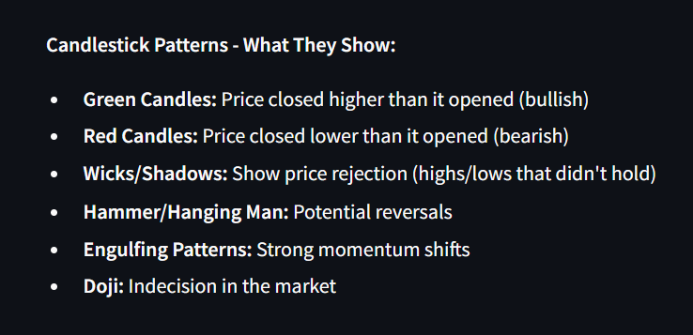
Candlestick Patterns & Market Behavior
Candlestick charts give deeper insights into market psychology. Green candles indicate bullish days, while red candles reflect bearish pressure. Patterns like Hammers, Engulfing formations, and Doji help us identify potential trend reversals or continuation zones. This is vital for short-term trading and technical timing.

Slide 10
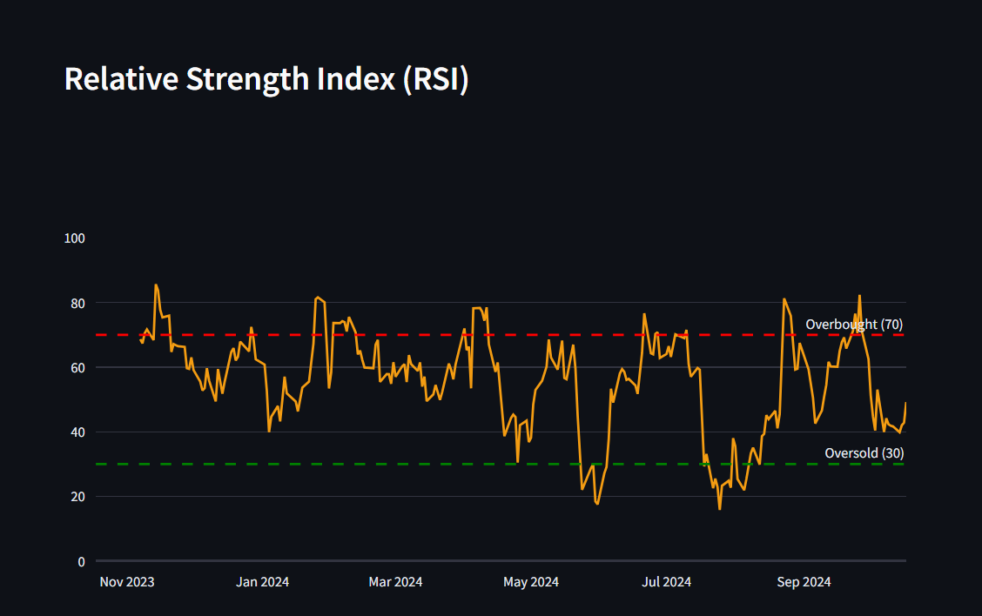
Technical Indicators
RSI – Overbought or Oversold?
What Is RSI?(Relative Strength Index)
RSI measures the speed and magnitude of price changes over a period (usually 14 days) to indicate momentum and identify overbought or oversold conditions.
RSI = 100 – (100 / (1 + RS))
Where RS = (Average Gain over N periods) / (Average Loss over N periods)
The RSI tells us if the stock is currently overbought or oversold.
Above 70 → the stock may be overbought, risk of pullback.
Below 30 → potential bounce as it may be oversold.
Divergences between RSI and price can signal upcoming reversals.

Slide 11
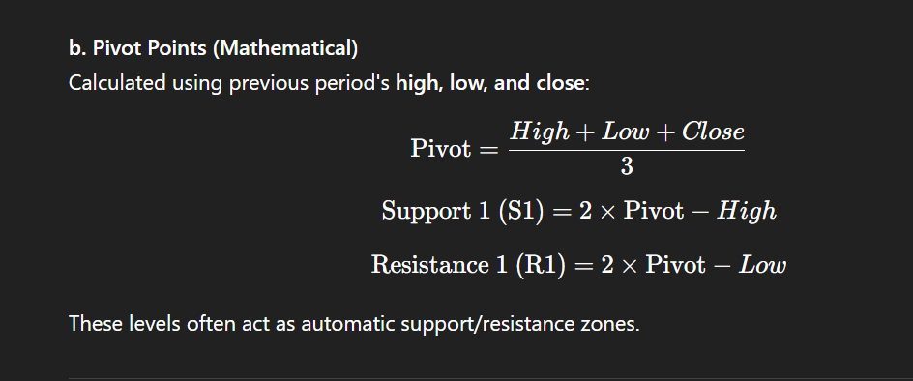
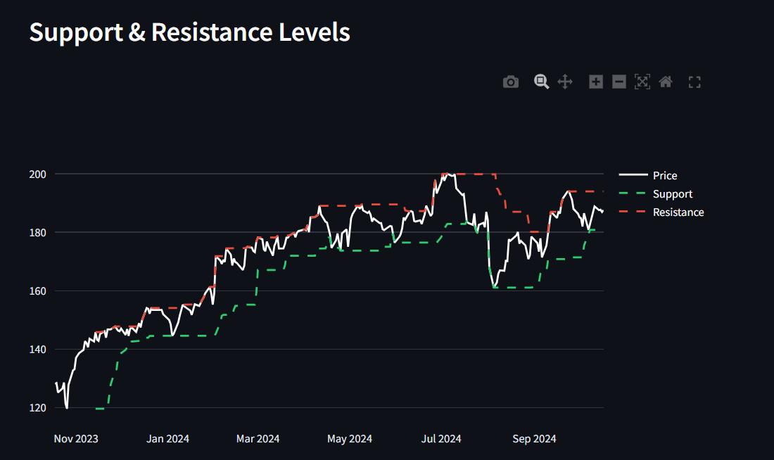
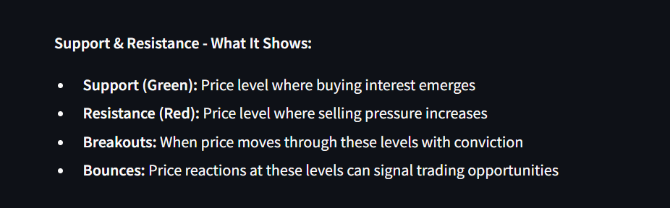
Key Support & Resistance Zones
Support and resistance are key levels where price reacts. Support zones show where buyers step in, while resistance shows selling pressure. We also monitor breakouts or bounces at these levels for tactical trade entries.

Slide 12
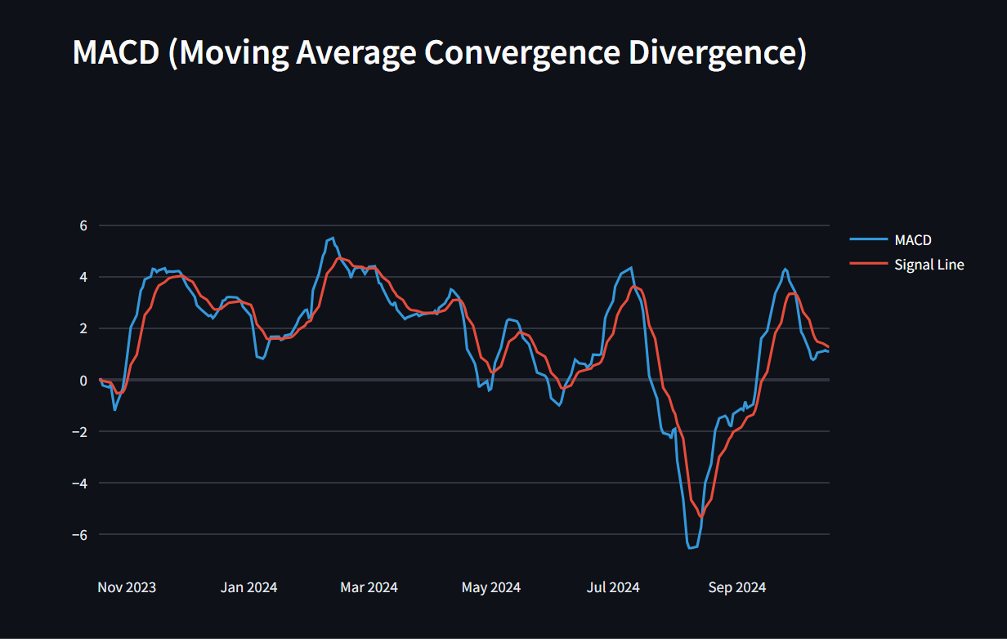
MACD – Moving Average Convergence Divergence
MACD helps us understand momentum and trend shifts:
The MACD line (blue) shows short-term vs long-term trend gaps. Shows short-term momentum vs long-term trend
The Signal line (red) helps smooth signals. Smoother version to filter noise and confirm signals
Crossovers suggest bullish or bearish momentum. It doesn’t guarantee a reversal but signals weakening trend strength.
When MACD crosses the zero line, it often confirms a larger trend reversal.
After calculating the MACD and Signal line, we use their crossovers to detect buy/sell points, the zero line to confirm trend direction, and the histogram to measure the strength of momentum shifts. Together, these help us anticipate market reversals or trend continuations before they appear on price charts.

Slide 13
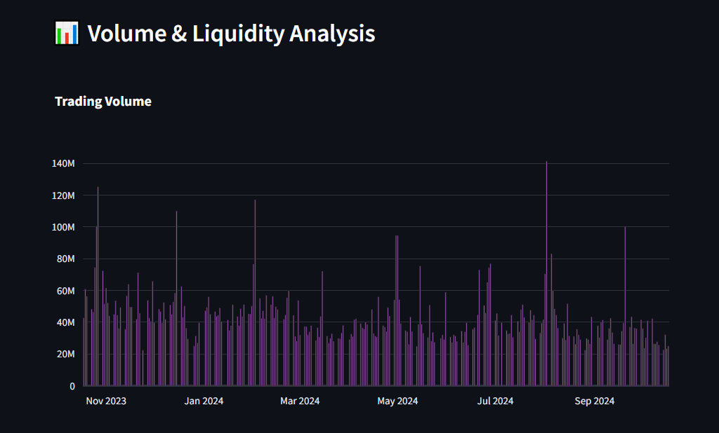
Volume & Liquidity Analysis
Volume & Liquidity Analysis
Volume tells us the truth behind price. Without volume, price moves may be weak or deceptive. By analyzing volume with price action, we confirm the strength of trends, identify breakouts, and gauge the liquidity of the stock
Liquidity means how easily and quickly a stock can be bought or sold without causing a significant change in its price.
High liquidity = Many buyers and sellers → tighter bid/ask spread → stable price movement.
Low liquidity = Fewer participants → larger price swings → higher trading risk.
Volume Signals:
High volume on up days = Strong buying interest
High volume on down days = Strong selling pressure
Volume spikes often precede big price moves

Slide 14
Fundamental Analysis Metrics
Metric | What It Tells Us | Conclusion / Signal
P/E Ratio | Price-to-Earnings ratio. High = overvalued or growth expected. Low = undervalued or weak outlook. | Compare to industry average. A low P/E may indicate a good entry or poor future.
EPS | Earnings Per Share. Profitability per share. Higher = more profitable. | Indicates how much money the company makes for each share. Look for rising EPS.
Revenue Growth | How fast a company’s sales are growing YoY. Shows demand, market expansion, and performance. | Higher is better. Look for consistent and above-industry growth.
Net Profit Margin | How much profit is made from each dollar of revenue. Efficiency indicator. | High margin = good cost control. Look for improving or stable margins.
ROE | Return on Equity. Profit generated from shareholders’ equity. | >15% is excellent. Shows how well capital is being reinvested.
Debt to Equity | Leverage ratio. Indicates how much debt a company uses to finance operations. | Lower is safer. High D/E could signal risk unless justified by strong returns.
Dividend Yield | Annual dividend / price. Attractive to income investors. | High yield can be attractive — but too high may signal risk or unsustainable payouts.
Free Cash Flow (FCF) | Cash left after CapEx and OpEx. Critical for reinvestment and dividends. | Positive FCF = financially healthy. Look for growing FCF over time.
This matrix provides a snapshot of a company’s financial health, valuation, profitability, growth potential, and capital efficiency — all critical for long-term investors and value-oriented traders.
How to Use This in Your Slide Story
“By examining these fundamental indicators, we assess whether a company is undervalued, growing steadily, and managing its capital efficiently. Together, these metrics help identify sustainable businesses with strong financials — the ones that can weather volatility and deliver long-term value.”

Slide 15

Quantitative Analysis: CAPM Metrics
Purpose of These Metrics:
CAPM (Capital Asset Pricing Model) metrics help us quantify the stock’s risk and performance relative to the market, focusing on volatility (Beta) and excess return (Alpha). These are critical for portfolio managers and risk-aware investors.
β Range | Meaning | Conclusion
β = 1 | Moves in sync with market | Neutral volatility
β > 1 | More volatile than market | Higher risk, higher potential return
β < 1 | Less volatile than market | Lower risk, more stable
β < 0 | Moves opposite to market | Rare, can be a hedge asset
α Range | Meaning | Conclusion
α > 0 | Beating market-adjusted expectations | Good stock selection by management
α = 0 | Performance is in line with expectations | Neutral, not outperforming
α < 0 | Underperforming market-adjusted returns | Not delivering expected value for its risk level
Looking at Beta and Alpha, we can gauge not just the stock’s volatility, but whether its returns are justified. With a Beta of 1.46, this stock is riskier than average, and with a near-zero Alpha, it has not compensated investors adequately for that extra risk. This indicates a volatile but underperforming profile.

Slide 16
Key Performance Analysis (KPA)
Is the stock currently overvalued or undervalued?
Answer: The stock's P/E ratio is 45.50, which suggests it is overvalued.
Explanation: A lower P/E ratio (under 15) may indicate the stock is undervalued, while a higher P/E (over 30) might mean it's overvalued relative to earnings.
Is the stock price likely to grow?
Answer: Analyst target price is 218.90, suggesting a potential increase of 31.37 USD.
Explanation: Target prices are analyst predictions for future stock value. A higher target than current price suggests expected growth.
Is the company profitable?
Answer: Yes, the company has a positive EPS of 4.18.
Explanation: Earnings per Share (EPS) indicates how much profit is allocated per share. Positive EPS means the company is generating profit.

Slide 17
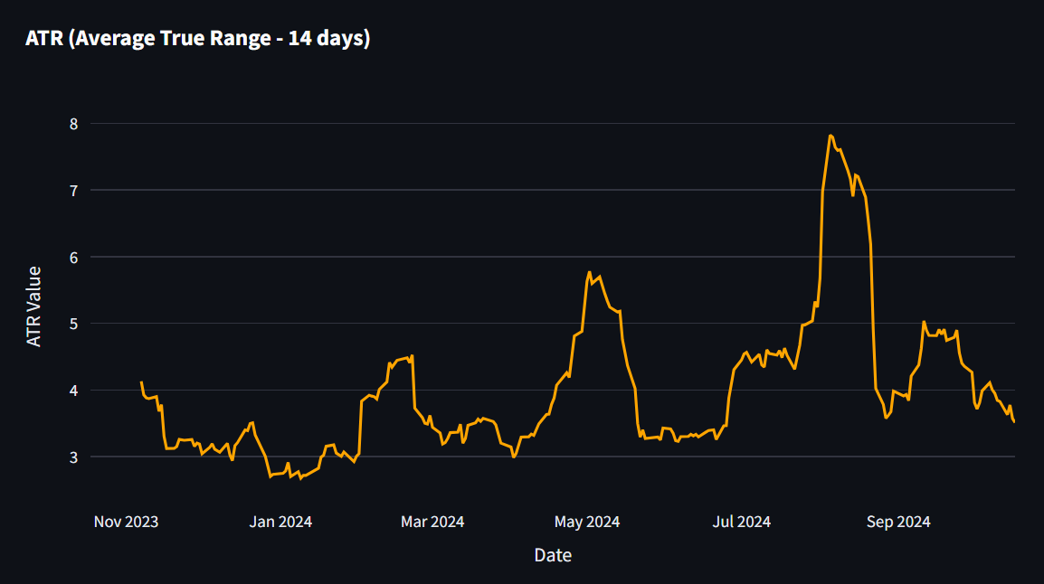
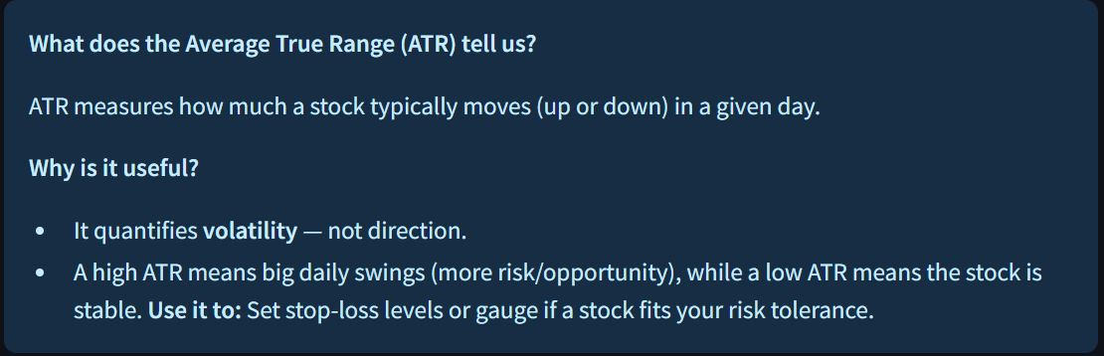
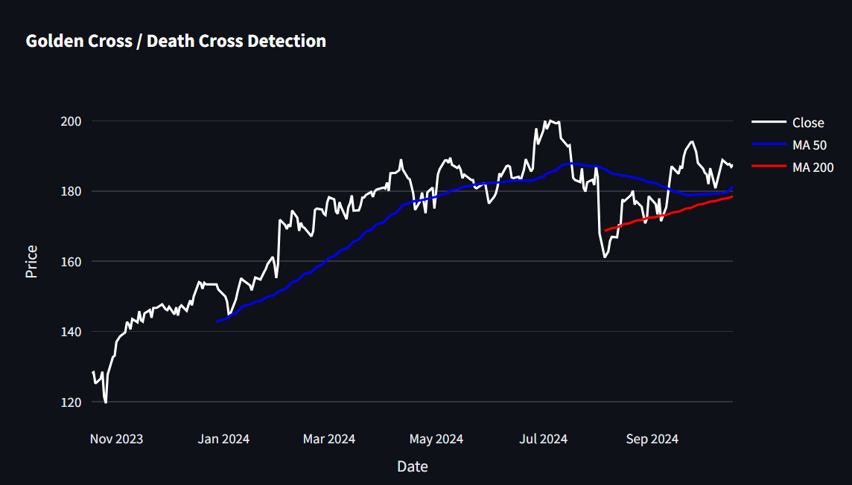
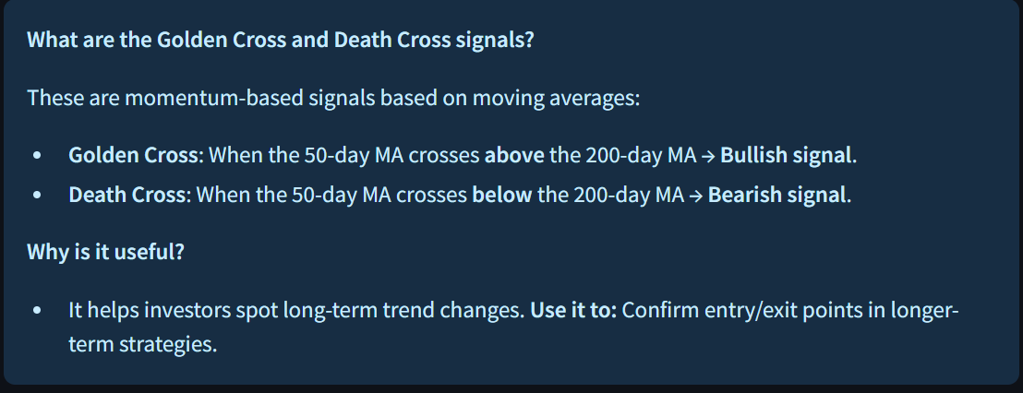
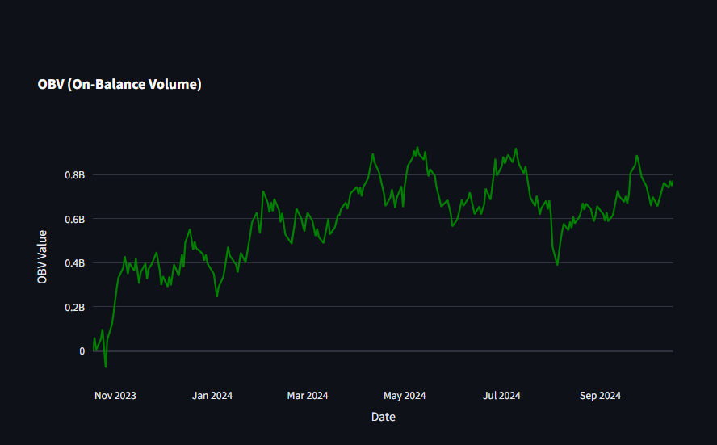
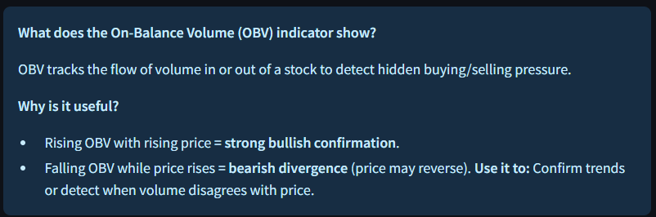
Is the stock actively traded?

Slide 18
Advanced KPIs: Risk-Adjusted Performance
1. Sharpe Ratio
2. Sortino Ratio
Measures the excess return earned per unit of total risk (standard deviation).
Considers all volatility (both upside and downside).
Measures excess return per unit of downside risk (ignores positive volatility).
Focuses only on harmful fluctuations.
Sharpe Ratio | Conclusion
> 1.0 | Strong risk-adjusted return (ideal)
0.5 – 1.0 | Moderate performance
< 0.5 | Weak risk-adjusted return – low reward for risk taken
Sortino Ratio | Conclusion
> 2.0 | Excellent downside protection with strong returns
1.0 – 2.0 | Good performance with limited downside risk
< 1.0 | Poor downside-adjusted returns – frequent or severe dips
When we factor in risk, both the Sharpe (0.09) and Sortino (0.14) Ratios show weak performance. The stock carries significant volatility and downside risk, but without delivering strong excess returns. These low ratios highlight the importance of assessing not just returns — but how risky those returns are to achieve.

Slide 19
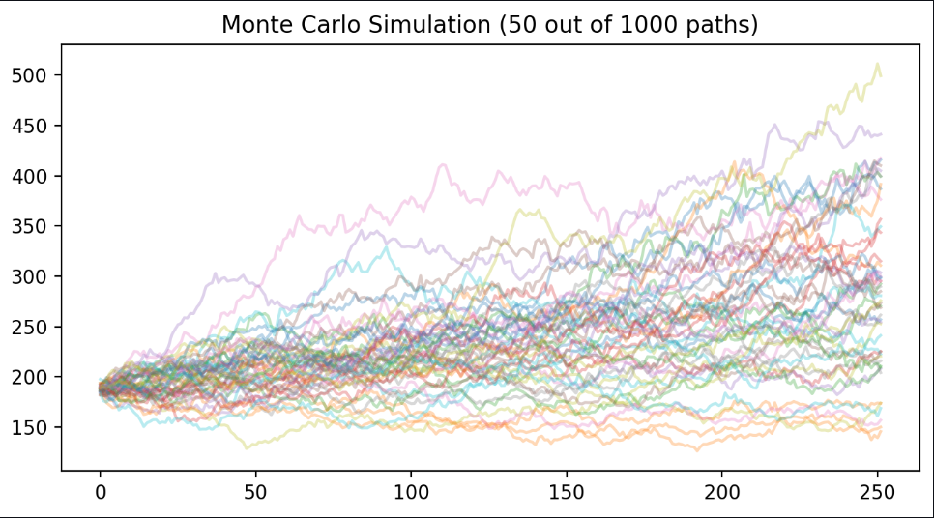
Monte Carlo Simulation – Risk Forecasting
What Is It?
A statistical simulation technique that runs thousands of future price scenarios.
Uses historical volatility and returns to model randomness in price movement.
Reflects real-world uncertainty in stock performance.
Why Do We Use It?
To estimate future price ranges and probability of outcomes.
To assess risk and reward scenarios.
To visualize the distribution of potential future values.
What Does It Show Us?
Range of outcomes (not one exact prediction).
Probability of hitting a target price or experiencing losses.
Helps evaluate questions like:
"What’s the chance this stock will fall below $X?"
"How likely is it to grow to $Y in 6 months?"

Slide 20
Stage 2: Comparative Financial Insights
From Individual Deep Dives to Strategic Comparison
In the previous stage, we explored each FAANG company individually, focusing on technical trends, price behavior, and performance signals.
Now, we shift our perspective to comparative analysis — identifying strengths, weaknesses, and market positioning across companies using key performance indicators (KPIs).
Through this lens, we'll answer questions like:
Which company shows the highest growth momentum?
Who delivers the best return for investors?
Are any stocks currently undervalued or overvalued?
The upcoming slides will visualize and interpret the most insightful metrics across valuation, profitability, growth, and risk — all designed to support data-driven investment decisions.

Slide 21
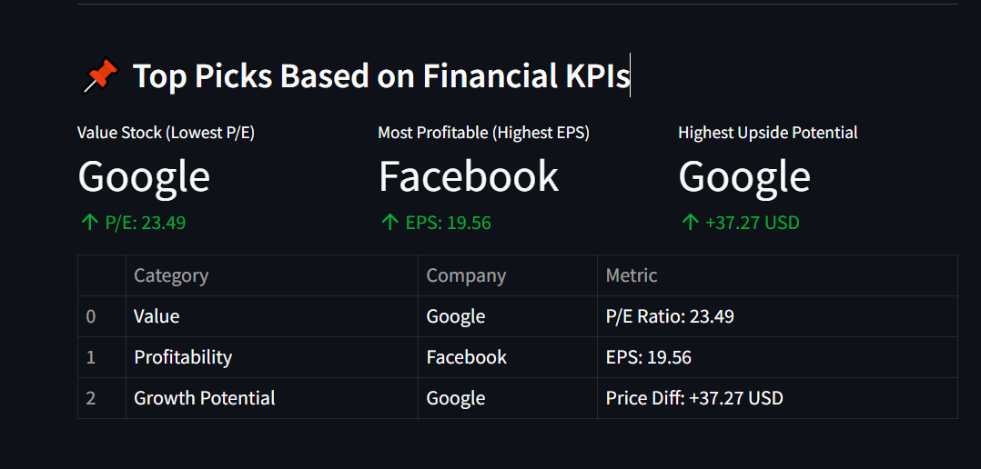
Top Picks Based on Financial KPIs
Google stands out as both the best value stock and the company with the highest growth potential, offering a compelling investment case.
Facebook leads in profitability, delivering the highest earnings per share among FAANG stocks.
These picks are derived purely from financial KPIs — not market sentiment — to provide a data-driven view of leadership.

Slide 22
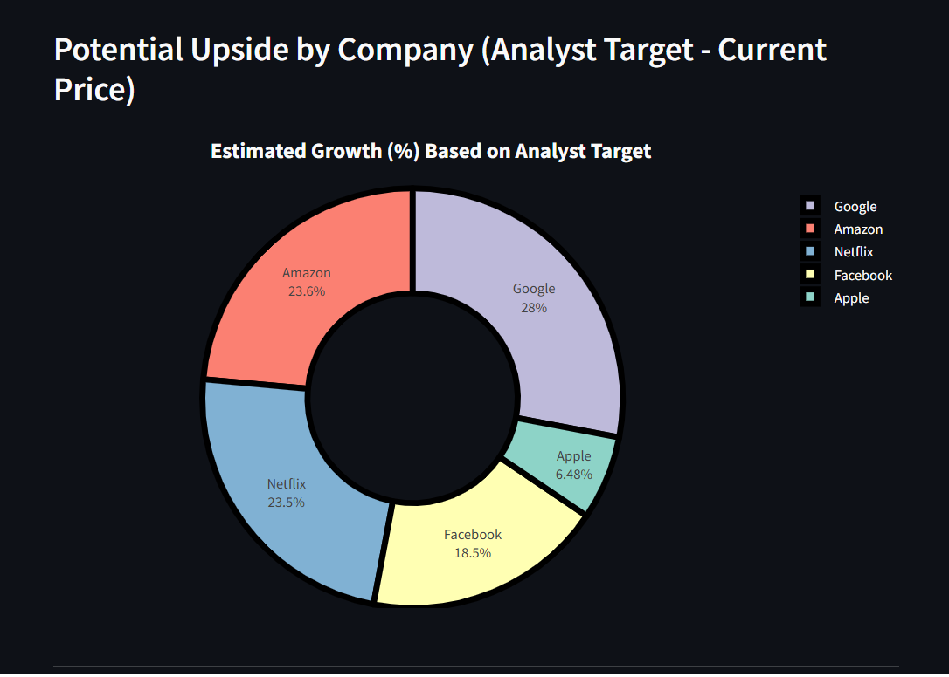
Potential Upside by Company
(Analyst Target Price – Current Price)
What does this chart show? This donut chart visualizes the relative growth potential of each FAANG company based on how far their analyst target price exceeds the current stock price.
What the segments mean:
Each slice represents a company's contribution to the total upside potential.
Larger slices = Greater price increase expected by analysts.
Why is it useful?
Helps investors compare growth expectations across companies.
You can quickly spot which stocks analysts believe are undervalued or poised for a breakout.

Slide 23
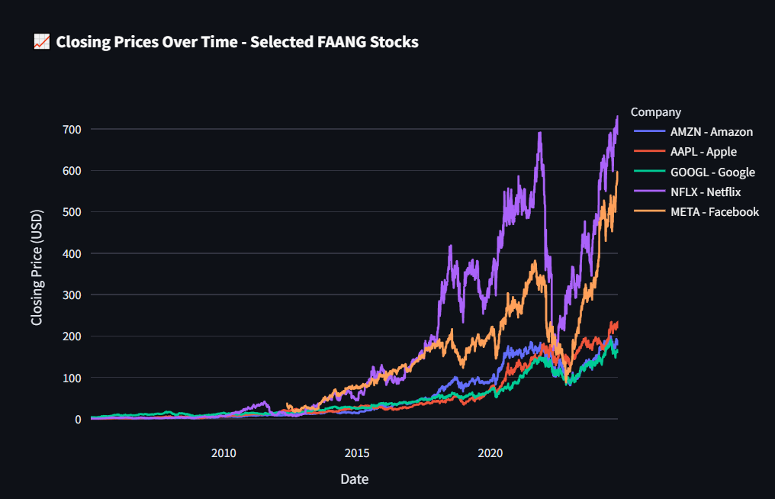
What was the change in price of the stock overtime?
Closing Price Trends Over Time
What does the line chart show?
This plot tracks the daily closing stock prices of the selected FAANG companies over a given time period.
Each line represents a different company, allowing you to compare price performance over time.
Why is it useful?
Helps you visually assess long-term trends, growth patterns, or periods of volatility.
Enables performance comparison between companies.
Can reveal:
Consistent upward or downward trends.
Market corrections or growth spurts.
Which companies are the most stable.

Slide 24
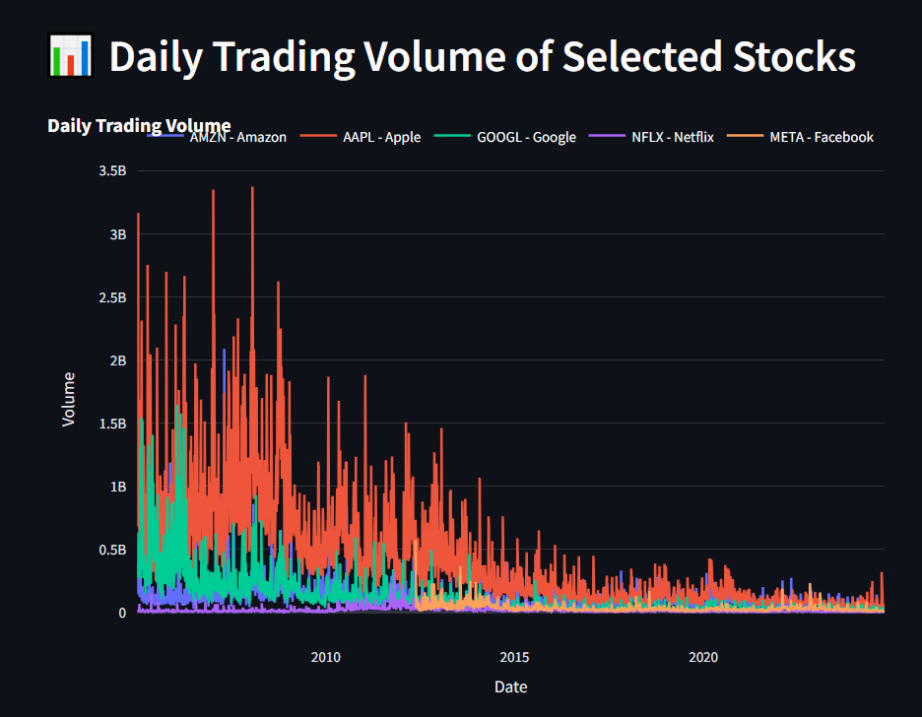
Daily Trading Volume Analysis
What does this chart show?
It shows the number of shares traded per day for each selected stock.
Spikes indicate increased investor activity, possibly due to news, earnings reports, or market events.
Why is volume important?
High trading volume = High liquidity and stronger investor interest.
Sudden volume spikes often precede major price movements.
Consistently low volume may suggest weak investor attention or illiquidity.

Slide 25
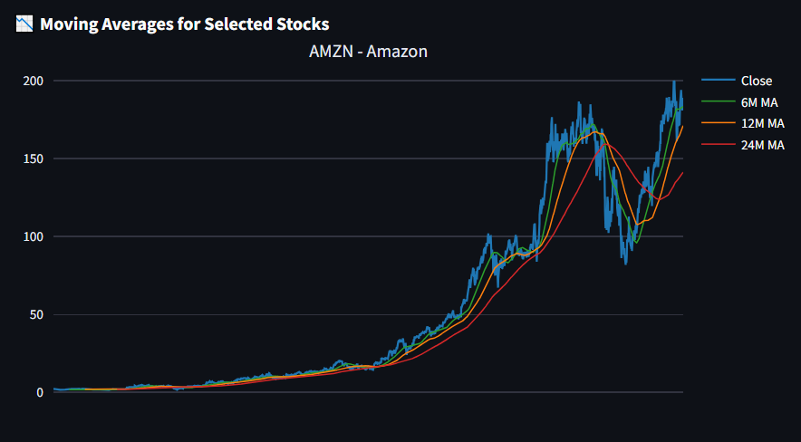
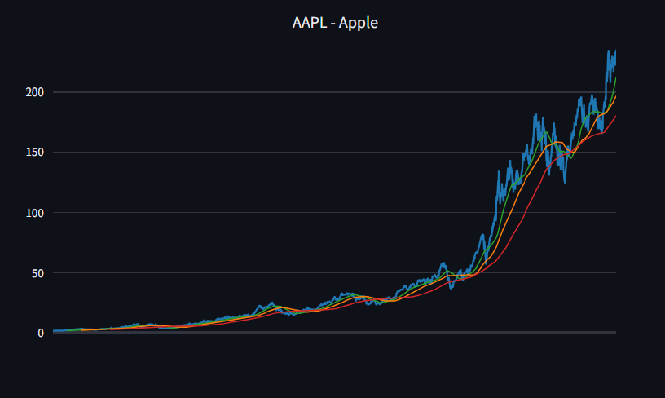
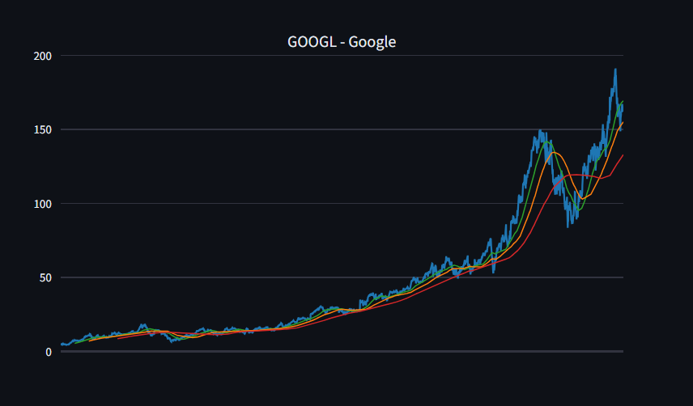
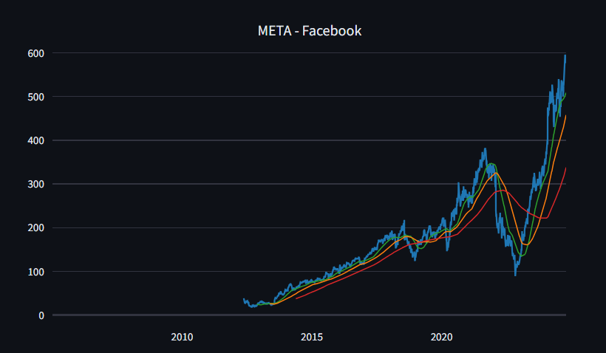
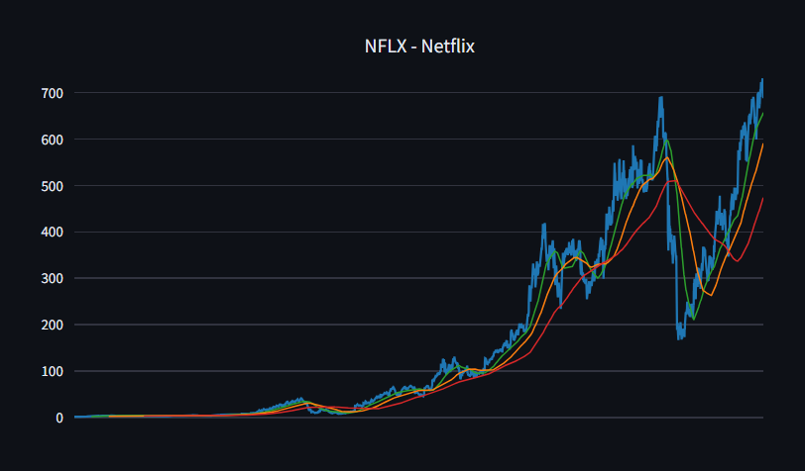
What was the moving average of the various stocks?¶
Moving Averages Analysis (6M, 12M, 24M)
What does the plot show?
This multi-row plot shows closing prices and three different moving averages (6-month, 12-month, 24-month) for each selected FAANG stock.
Each subplot represents a single company.
The moving averages are computed as:
6M MA: Short-term trend (126 trading days)
12M MA: Medium-term trend (252 trading days)
24M MA: Long-term trend (504 trading days)
Why Moving Averages Matter:
Smoothing: Reduces daily noise to reveal underlying trends.
Trend Confirmation:
If price is above long-term MA → bullish signal.
If price crosses below MAs → potential correction signal.
Investor Insight:
6M MA shows recent performance.
12M MA tracks yearly performance.
24M MA shows long-term health of the stock.

Slide 26
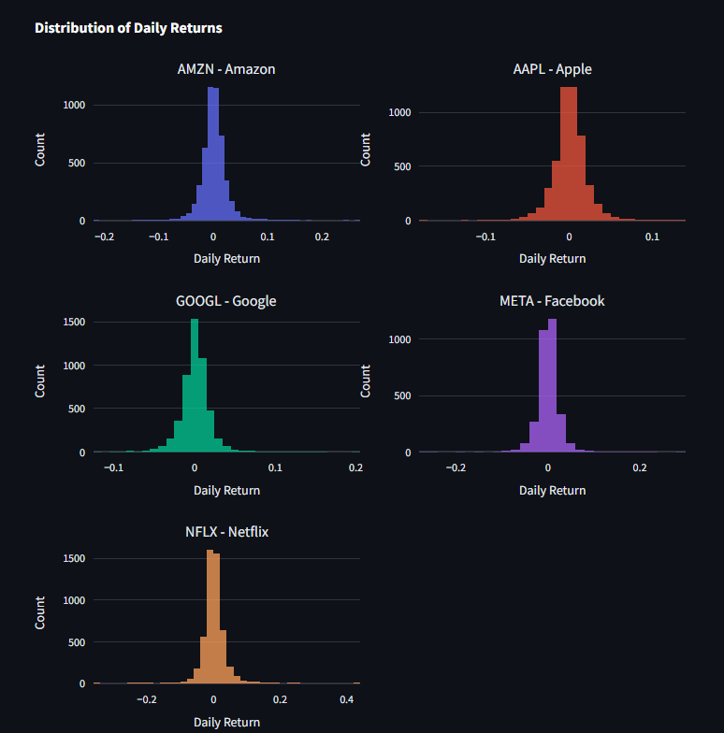
What was the daily return of the stock on average?
Daily Return Distributions
What the Plot Shows:
This slide visualizes the distribution of daily returns (i.e., percentage changes in stock price from one day to the next) for each selected FAANG stock.
Each subplot is a histogram representing how often specific return values occurred over time.
Helps visualize volatility and risk behavior of each company.
Symmetry vs. Skewness:
A symmetric bell shape suggests normally distributed returns.
A long tail on either side suggests the presence of outliers or volatility spikes.
Spread of the Distribution:
Wider distributions → higher volatility (e.g., Netflix or Meta).
Narrower distributions → more stable stocks (e.g., Apple or Microsoft).
Outlier Frequency:
Frequent extreme returns may indicate higher trading
risk or market sensitivity.
What Daily Return Means:
Daily Return = (Today′sClose−Yesterday′sClose)/Yesterday′sClose(Today's Close - Yesterday's Close) / Yesterday's Close(Today′sClose−Yesterday′sClose)/Yesterday′sClose
It reflects the day-to-day price fluctuation of a stock.

Slide 27
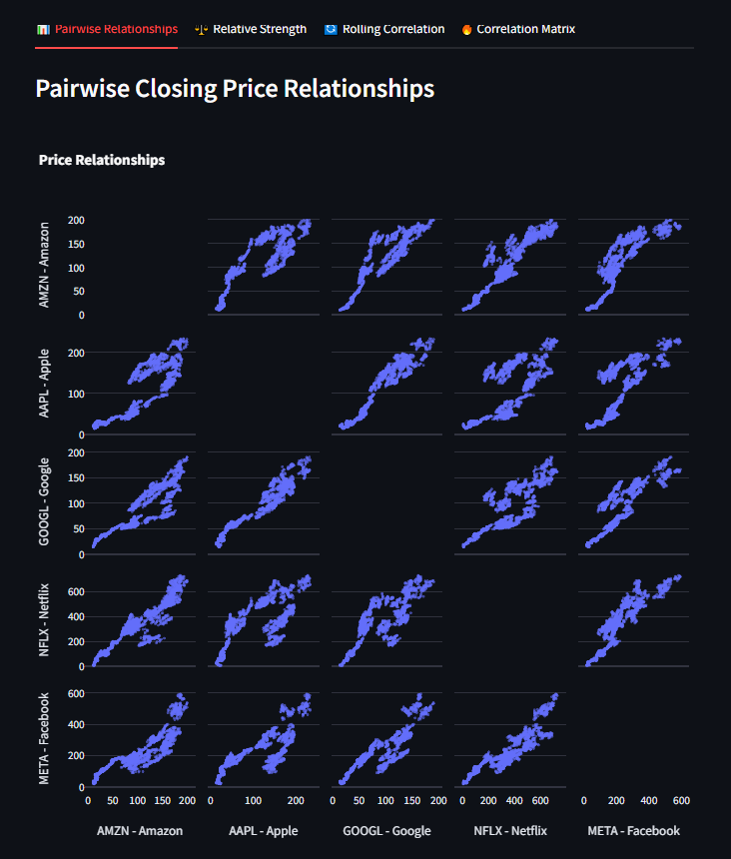
What was the correlation between different stocks closing prices?
Pairwise Closing Price Relationships
(Exploring Price Interactions Between Stocks)
What does it show?
A scatter matrix comparing pairwise relationships between the closing prices of selected stocks.
Each cell shows a scatterplot of one stock’s price vs another, helping us visually check if there's a linear relationship
Why we chose it:
It provides a quick visual overview of how similar the price patterns are across stocks.
Useful for spotting strong linear trends, clusters, or anomalies.
What we can conclude:
If dots form a tight line, the two stocks are strongly positively correlated.
A cloud of scattered points implies weak or no correlation.
Helps detect redundancy in stock selection (e.g., two stocks that move identically).

Slide 28
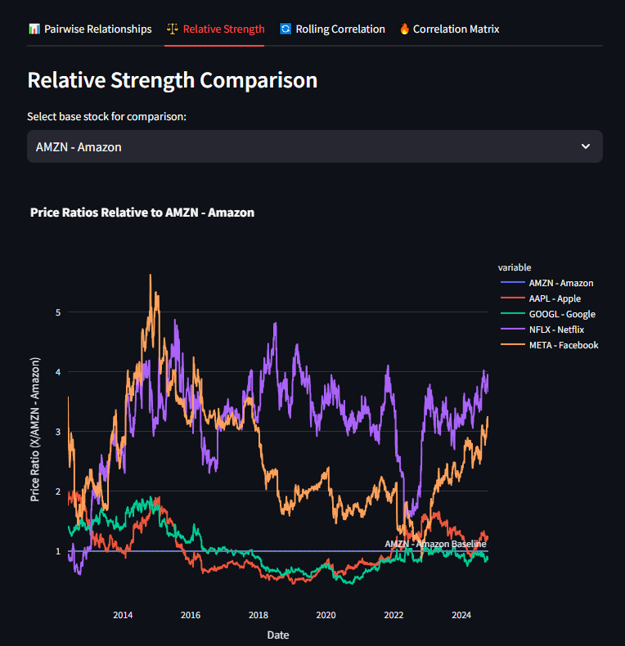
Relative Strength Comparison
(Tracking Relative Strength Across Stocks)
What does it show?
A line plot of the price ratio of each stock relative to a selected base stock over time.
Shows how much stronger or weaker a stock is compared to another.
Why we chose it:
Highlights relative outperformance or underperformance.
Common in technical analysis to compare assets in a portfolio or sector.
What we can conclude:
A line above 1.0 means the stock has gained more than the base stock.
A rising line = increasing strength vs base; falling = weakening.
Great for identifying leaders and laggards among the group.

Slide 29
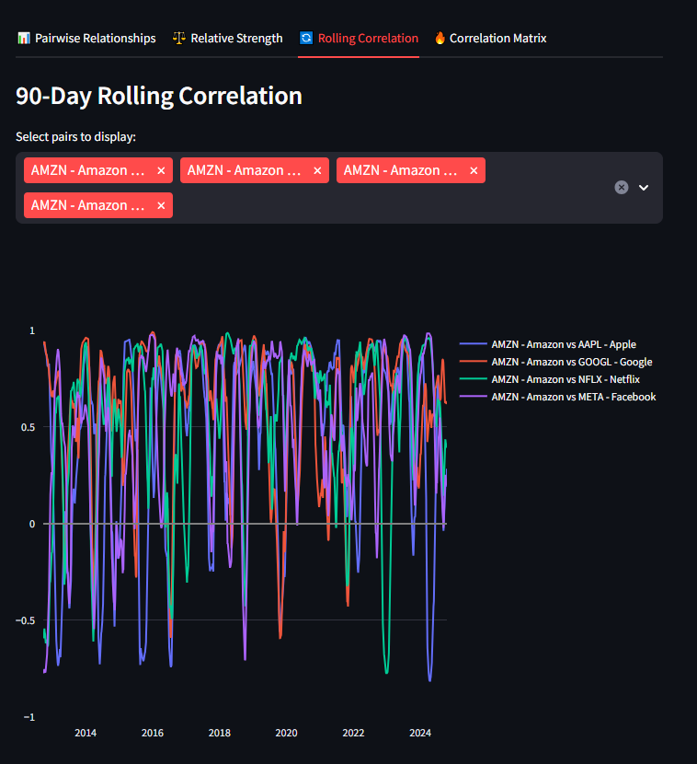
90-Day Rolling Correlation
(Time-Varying Correlation Trends)
What does it show?
The correlation over time (using a rolling window of 90 days) between selected stock pairs.
Each line represents how the relationship between two stocks changes over time.
What we can conclude:
Correlation values near +1 indicate tight positive movement.
Correlations that drop toward 0 or negative suggest divergence or independence.
Helps in diversification planning — prefer stocks with lower or shifting correlations.
Why we chose it:
Stock correlations aren’t static — this view captures dynamic relationships.
Useful during market stress when correlations often increase.

Slide 30
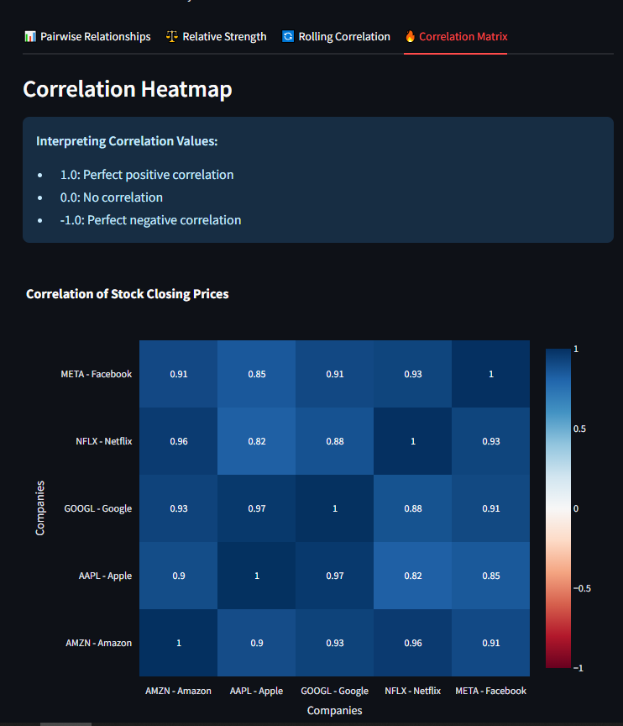
Correlation Matrix (Heatmap)
(Snapshot of Inter-Stock Correlation)
What does it show?
A static heatmap of the Pearson correlation coefficients between each stock pair.
Colored from blue (negative) to red (positive) based on strength.
Why we chose it:
Gives a summary view of how all stocks relate.
Makes it easy to spot clusters of stocks that are highly related.
What we can conclude:
High values (closer to 1) = move together, possibly same sector/industry.
Low/negative values suggest diversification potential.
Helps in portfolio construction to avoid over-concentration in correlated assets.

Slide 31
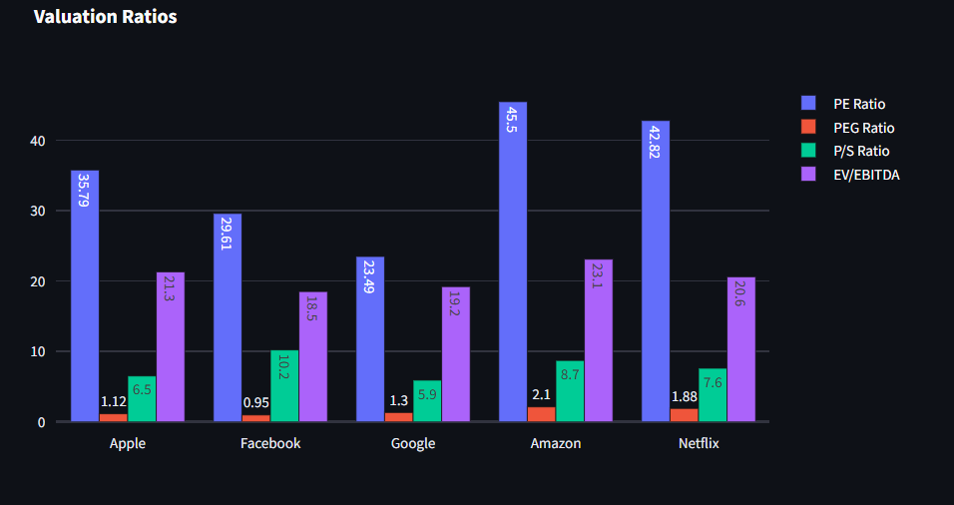
Valuation Metrics
What it shows: The grouped bar plot compares each company’s key valuation ratios: P/E, PEG, P/S, and EV/EBITDA. It visually highlights how the market prices each company relative to earnings, growth, sales, and operating cash flow.
Why we chose it: These ratios are essential for investors to assess whether a stock is undervalued or overvalued compared to peers or industry standards. They adjust for profitability, growth potential, and capital structure.
What we can conclude:
A lower P/E or EV/EBITDA may indicate a potential undervaluation.
A PEG ratio below 1 suggests that the company’s earnings growth is not yet priced in, indicating potential for upside.
High P/S may signal overvaluation unless backed by strong revenue growth.

Slide 32
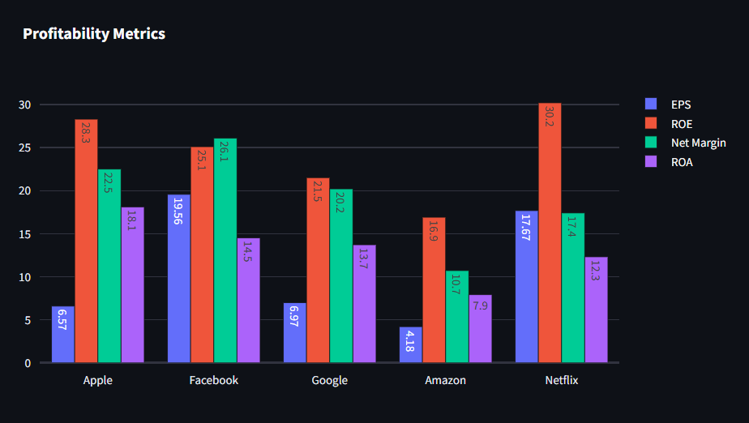
Profitability Metrics
What it shows: This plot compares each company’s ability to generate profits, showing EPS, ROE, Net Margin, and ROA.
Why we chose it: Profitability is a core factor in assessing a company's financial strength and sustainability. These metrics reflect how well a company turns revenue and equity into actual profit.
What we can conclude:
Higher EPS and Net Margin signal strong bottom-line performance.
A ROE > 15% is often a sign of superior management effectiveness.
High ROA suggests efficient use of total assets. Companies with strong profitability are often better equipped to weather downturns and reinvest in growth.

Slide 33
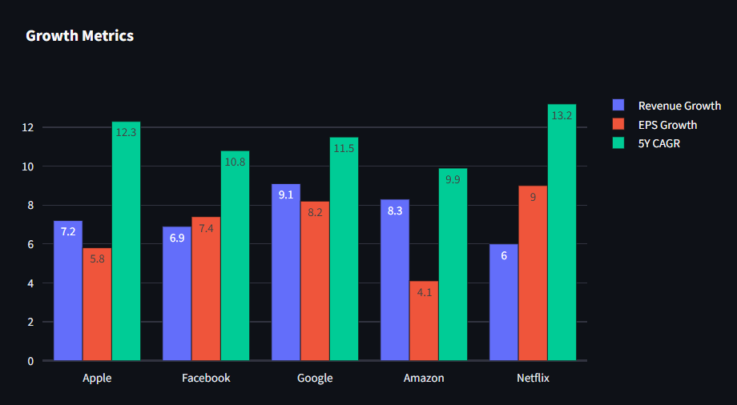
Growth Metrics
What it shows: This grouped bar plot shows how much each company is growing in terms of Revenue, EPS, and 5-Year CAGR (Compound Annual Growth Rate).
Why we chose it: Growth is crucial for long-term investors seeking capital appreciation. These metrics reflect how quickly the business is expanding — an indicator of future earnings and market dominance.
What we can conclude:
Consistently high revenue and EPS growth can lead to stronger future valuations.
A high 5Y CAGR shows that growth is sustained over time, not just a temporary spike. Investors may prefer companies with strong, stable growth trajectories.

Slide 34
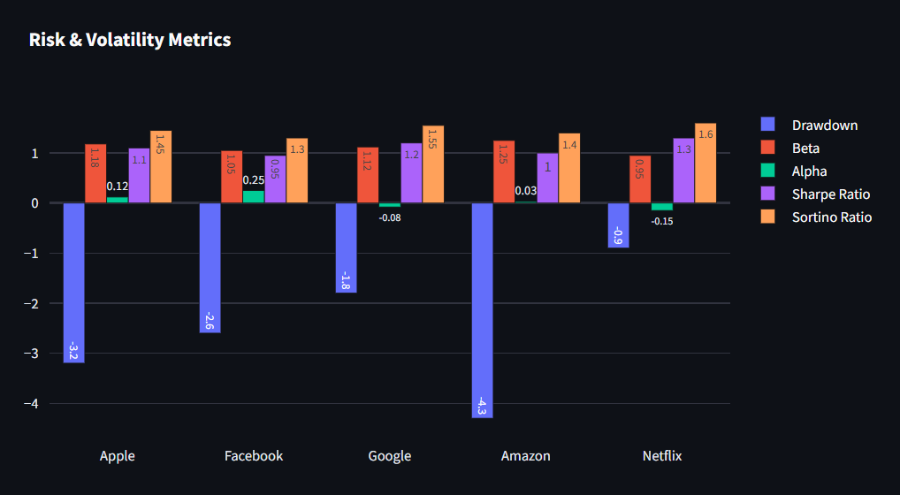
Risk Metrics
What it shows: This plot visualizes market and downside risk through Beta, Sharpe Ratio, Sortino Ratio, Alpha, and Drawdown.
Why we chose it: Risk metrics help investors balance potential returns with exposure to volatility and losses. They’re essential for portfolio construction, especially for risk-averse investors.
What we can conclude:
A Beta ~1 means the stock moves with the market; higher means more volatile.
A Sharpe/Sortino > 1 indicates a favorable return relative to total/downside risk.
Low Drawdown suggests capital preservation during market declines. Companies with high Sharpe/Sortino ratios and low drawdowns are more attractive for risk-adjusted returns.

Slide 35
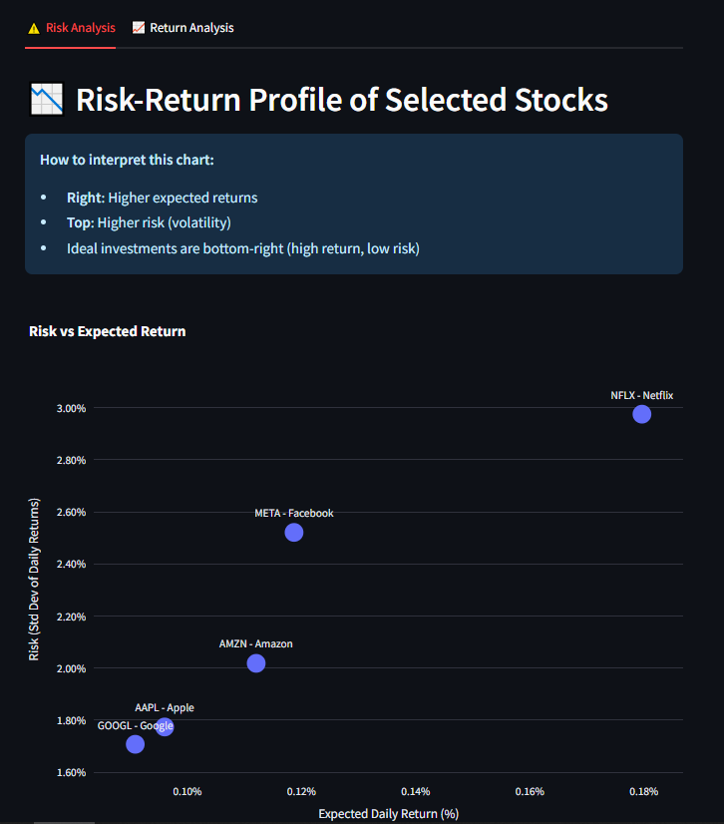
How much value do we put at risk by investing in a particular stock?
Risk Analysis
What it shows: This scatter plot visualizes each selected stock's expected daily return versus its volatility (standard deviation). Each stock is represented as a bubble, helping us quickly compare risk-return tradeoffs across the portfolio.
Why we chose it: This is a foundational chart in modern portfolio theory. It shows the risk-return tradeoff, which is essential for any investment decision. Investors want to maximize return while minimizing risk — this chart helps identify the most efficient investments.
What we can conclude:
Stocks in the bottom-right corner have higher returns with lower risk — ideal investments.
Top-left stocks carry high risk but low return, and are generally undesirable.
Clustering of stocks may suggest similar market behavior, while outliers require further analysis.
If most stocks cluster in the top-right, the investor may be exposed to higher volatility, and diversification strategies could be considered.
This plot is a quick way to filter attractive risk-return combinations and helps determine where risk-adjusted performance is strongest.

Slide 36
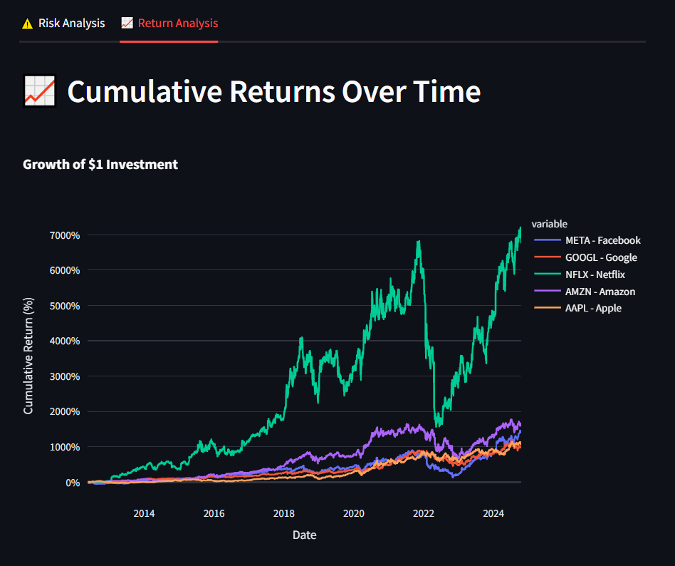
Return Analysis (Cumulative Return Over Time)
What it shows: This line plot illustrates the cumulative return of $1 invested in each selected stock over time. It simulates how a portfolio would have grown, assuming reinvestment of returns.
Why we chose it: Tracking cumulative returns helps investors visualize long-term performance and identify trends, market shocks, and momentum. It also provides an intuitive comparison of which stocks would have performed best historically.
What we can conclude:
Steeper curves indicate higher returns in shorter periods.
Plateaus or declines highlight periods of stagnation or loss.
If a company’s line consistently outpaces others, it may signal strong fundamentals or favorable market conditions.
A sharp dip followed by recovery suggests resilience, while prolonged dips may indicate systemic issues or poor investor confidence.
This chart is helpful for evaluating the historical consistency of returns and identifying long-term outperformers

Slide 37
Conclusion & Final Insights
This analysis provided a comprehensive comparison across major financial dimensions: Valuation, Profitability, Growth, and Risk/Return.
By examining P/E ratios, EPS, Net Margin, ROE, Revenue Growth, and Risk-Adjusted Returns, we identified the most promising investment opportunities among the selected companies.
These KPIs help investors make informed, data-driven decisions tailored to their risk tolerance and investment goals.
Whether you're seeking value, growth, or balanced risk—this dashboard provides a solid foundation for strategic investment planning.
THANK YOU !!!

